Slide 1
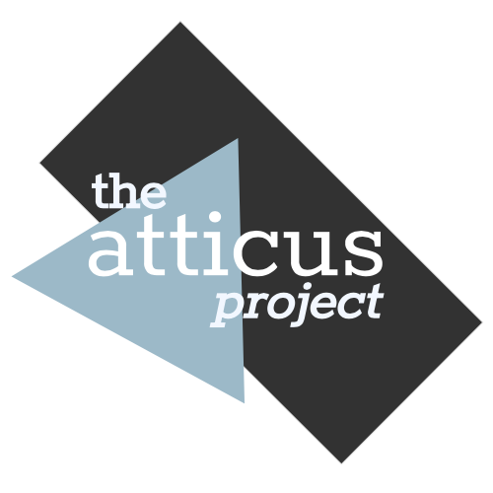
OpenAI in a Nutshell
Adaptable, comprehensive AI
© 2020 The Atticus Project

Slide 2
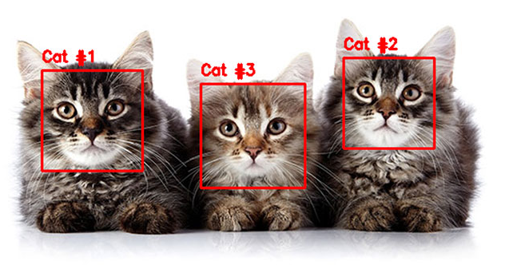
Review of Key Terminology
The full module on AI terminology can be found here.
AI
Machine Learning
AI that can learn from experience.
Natural Language Processing
AI that can understand language.
Annotated Data
Data that is tagged or labelled, usually by a human.
Unannotated Data
Data that is not tagged or labelled.
ML
NLP

Slide 3
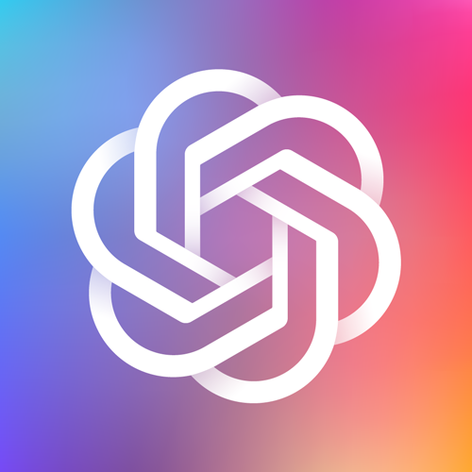
What is OpenAI?
OpenAI is a company for AI development and research with the goal of creating AI that is powerful, flexible, and benefits all of humanity.
Most of the work done by OpenAI falls under the umbrella of semi-supervised learning (also known as reinforcement learning).

Slide 4
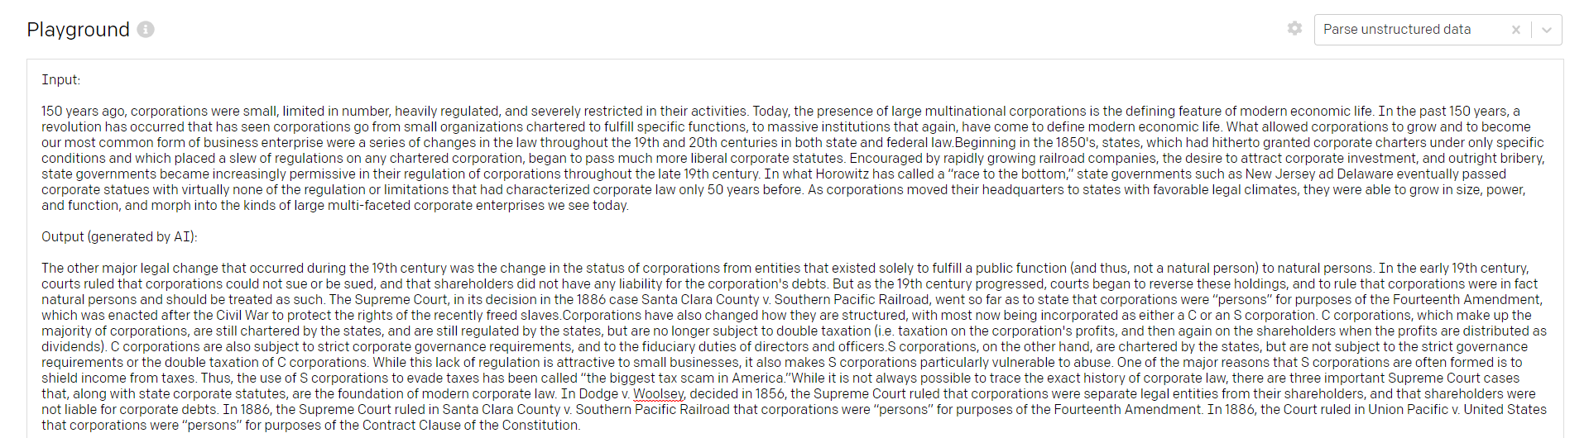
GPT-3
OpenAI recently launched a natural language processing model known as GPT-3. Built from a massive dataset of text from around the web, GPT-3 uses machine learning to recognize patterns in text. Given some form of text input, it can use the content and structure to either respond to that input or to predict what comes next.
OpenAI automatically generating supporting evidence for the beginning of an academic paper.

Slide 5
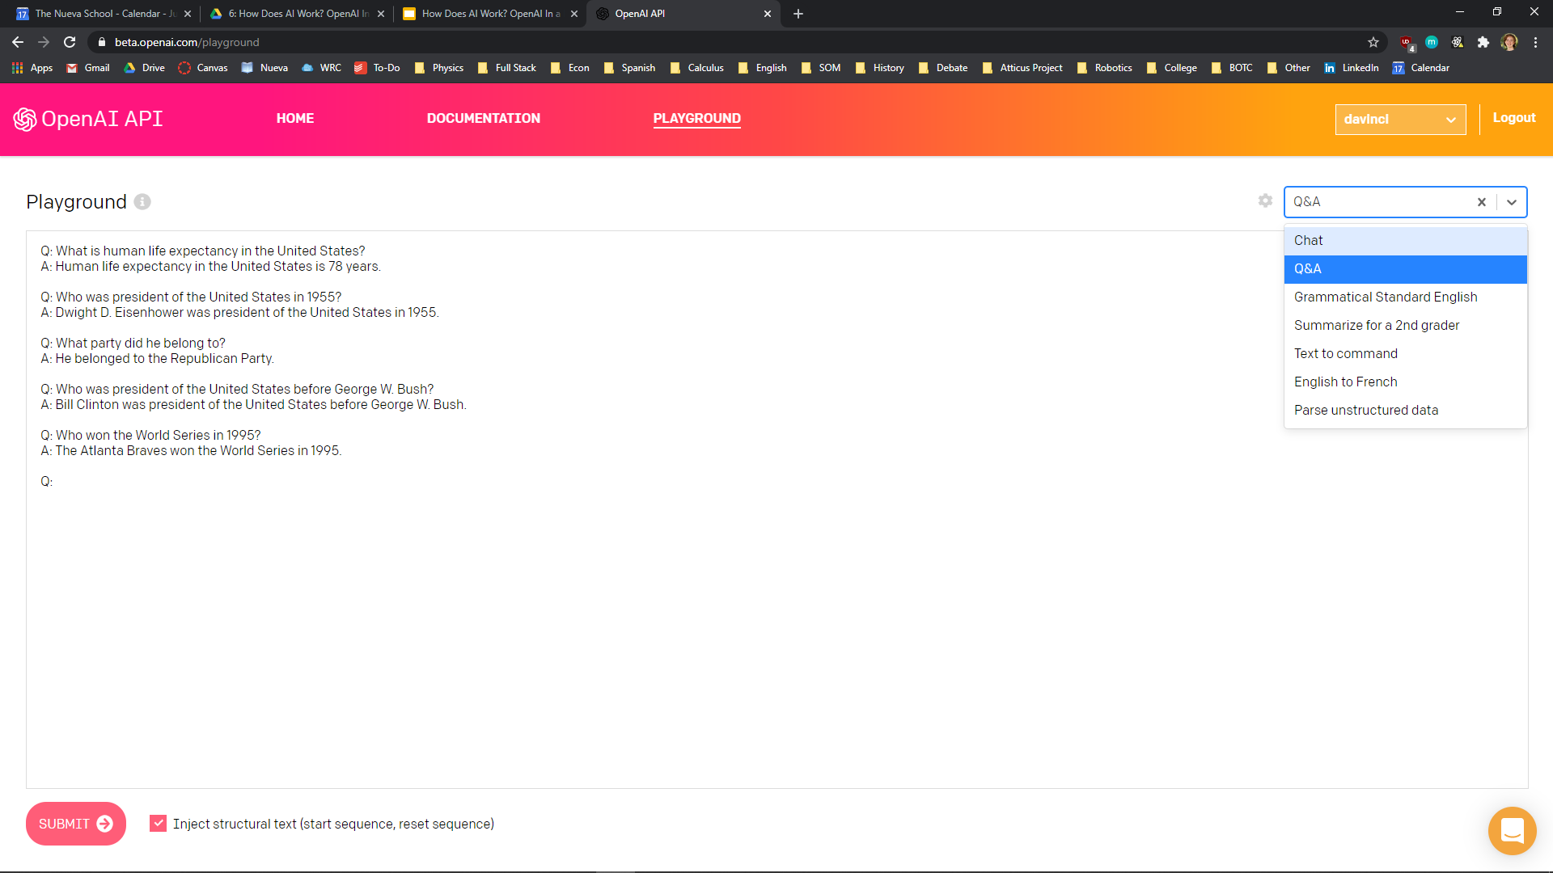
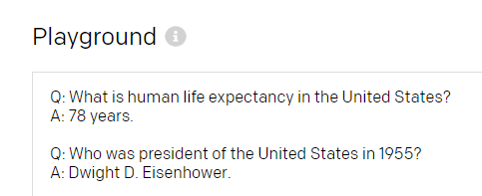
Web Interface
GPT-3, currently in beta, is available through an online playground with presets such as a chatbot, Q&A, and “summarize for a 2nd grader.”
In addition, users can give the AI example question and answer pairs to teach it the structure they want the output to look like. The model can learn from just one or two examples.
Sample structure provided by user
Subsequent output matches the structure

Slide 6
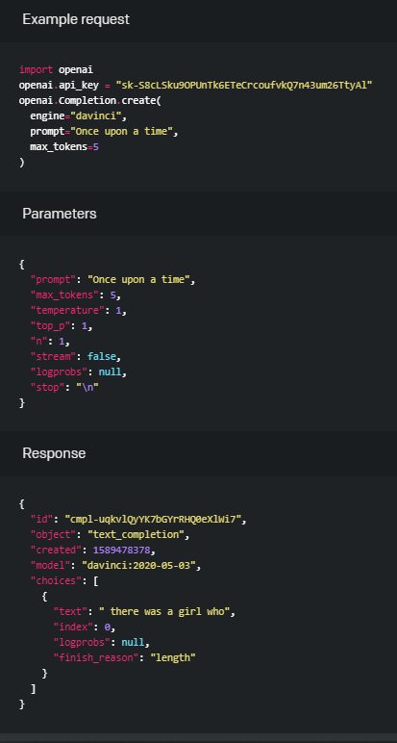
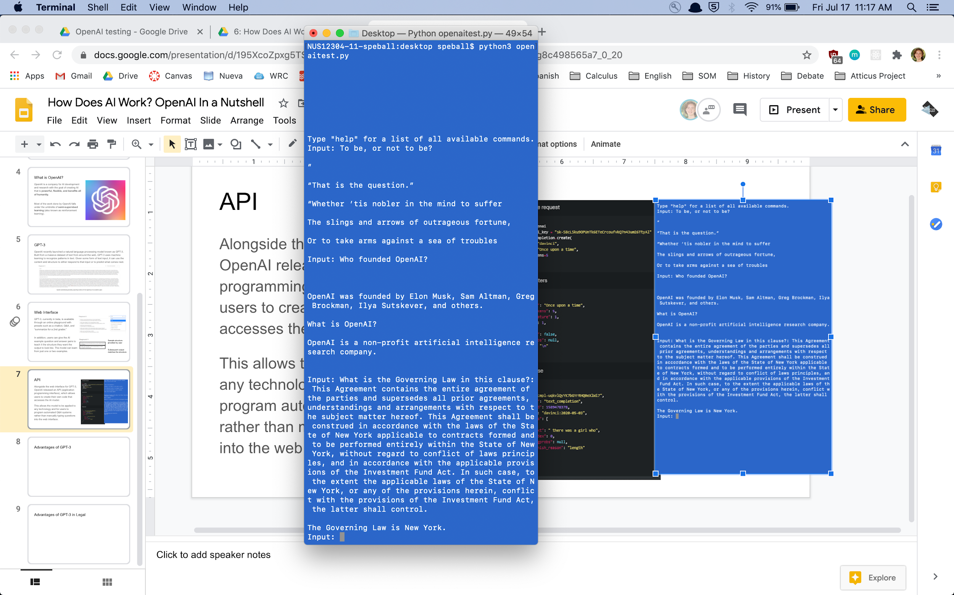
API
Alongside the web interface for GPT-3, OpenAI released an API (application programming interface), which allows users to create their own code that accesses the AI model.
This allows the model to be applied to any technology and for users to program automated Q&A systems rather than manually typing questions into the web interface.

Slide 7
Semi-supervised Learning
Semi-supervised models are models that learn from a small amount of annotated data alongside a large amount of unannotated data.
In the case of GPT-3, the unannotated data is the billions of texts from around the web it has learned from, whereas the annotated data is the user-provided context.
This combination allows for a general model that is fast and powerful, but remains endlessly customizable for individual user needs.

Slide 8
Advantages of GPT-3
Flexible for nearly any use case.
Whereas most AI models are designed for one specific purpose, GPT-3’s ability to learn structure through context allows it to be used for anything. In the legal industry, this means one tool that can be used for contract review, document automation, e-Discovery, and more.
Requires minimal training data.
GPT-3 has training data from almost any kind of information on the web already, meaning it doesn’t require thousands of pieces of user-provided data to start producing an accurate result.
Is simple and intuitive.
The web interface is clean and self-explanatory, and the API is more straightforward than most others.

Slide 9
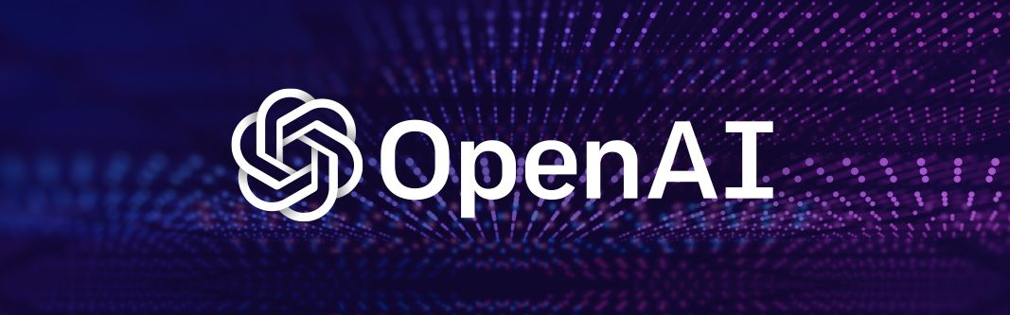
Read More
To learn more about OpenAI and GPT-3, visit their website, or these blog posts about the API and the unique strengths of the model.
OpenAI has developed several other technologies, such as the OpenAI Gym, a set of tools for developing reinforcement learning models, and OpenAI Five, an AI model that is learning how to play the competitive video game Dota 2.

